Slide 1

CU Anschutz Data Science Tour: From D2V to KDD
SEPTEMBER 2017
Seth Russell, MS
https://github.com/magic-lantern/biostatistics-seminar-2017

Slide 2

About Seth
Github:
https://gist.github.com/magic-lantern
https://github.com/magic-lantern/
https://github.com/magic-lantern/biostatistics-seminar-2017

Slide 3
About Seth
BS Business Administration – Central Washington University
BS Computer Science – Central Washington University
MS Biomedical Informatics – University of Utah
Capstone Project: Identification and Automation of Quality Metrics for Radiology Reporting in CT Pulmonary Angiography
https://github.com/magic-lantern/biostatistics-seminar-2017
Notes:
BA – This is where I got my start in statistics – required coursework for operations management portion of my business degree. I’ve held various lead positions in my career, so I’ve used my business education quite a bit – reports, finances, resource allocation, support models
CS – I received NSF funding to pay for this major. Held a range of positions related to software development and used a range of technologies – end result is I enjoy picking up new technology and doing something useful with it.
MS Degree – Chair was Stephane Maystree, also on my committee were Brian Chapman and Gang Luo
Natural Language Processing
EHR standards – Smart on FHIR
Automating decision aids

Slide 4
About Seth
Systems Analyst/Programmer @ Central Washington University
Programmer Analyst @ University of California
Software Engineer & Engineering Team Lead @ Backcountry.com
Senior Software Engineer & Team Lead @ Intermountain Healthcare
Research Instructor @ Data Science for Patient Value University of Colorado Anschutz
https://github.com/magic-lantern/biostatistics-seminar-2017
Notes:
CWU - Can learn from old technology – OpenVMS had file versioning built into the OS – every save created a new version (keep x previous versions)
UCSata Cruz - Application support, load testing, open source tools to fill in major gaps around proprietary systems.
Backcountry.com – Perl developer, designing user interaction as well as high performance web applications
Intermountain – will talk more about that soon.
Now research instructor/senior analyst in d2v program at the school of medicine
Held a range of positions related to software development and used a range of technologies – end result is I enjoy picking up new technology and doing something useful with it.

Slide 5
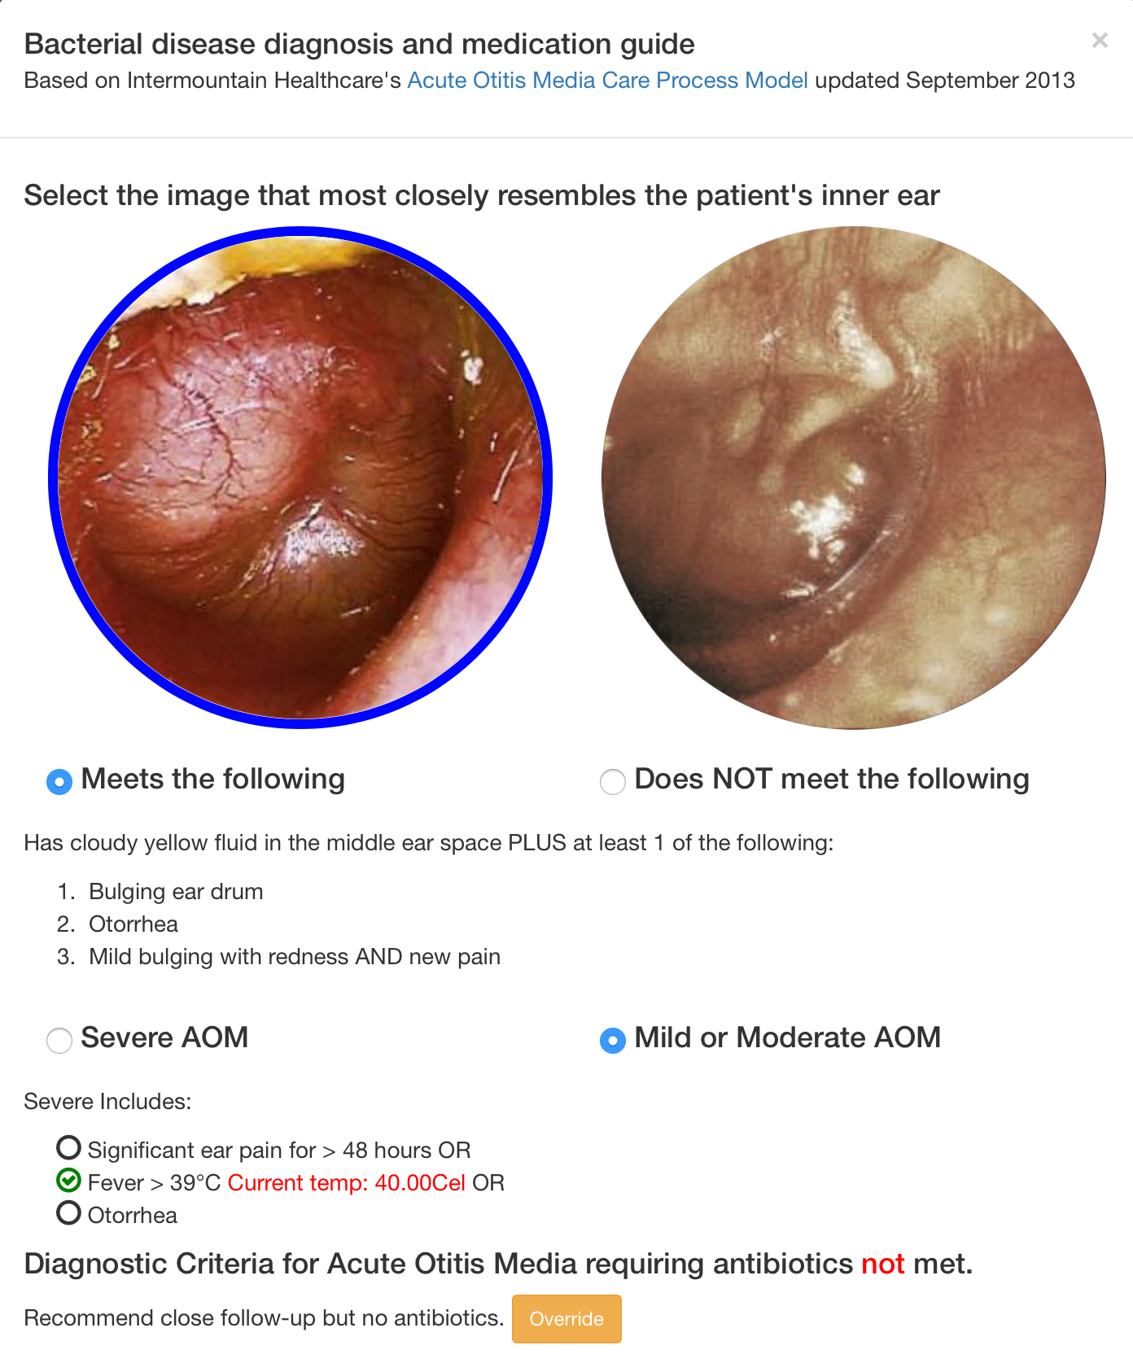
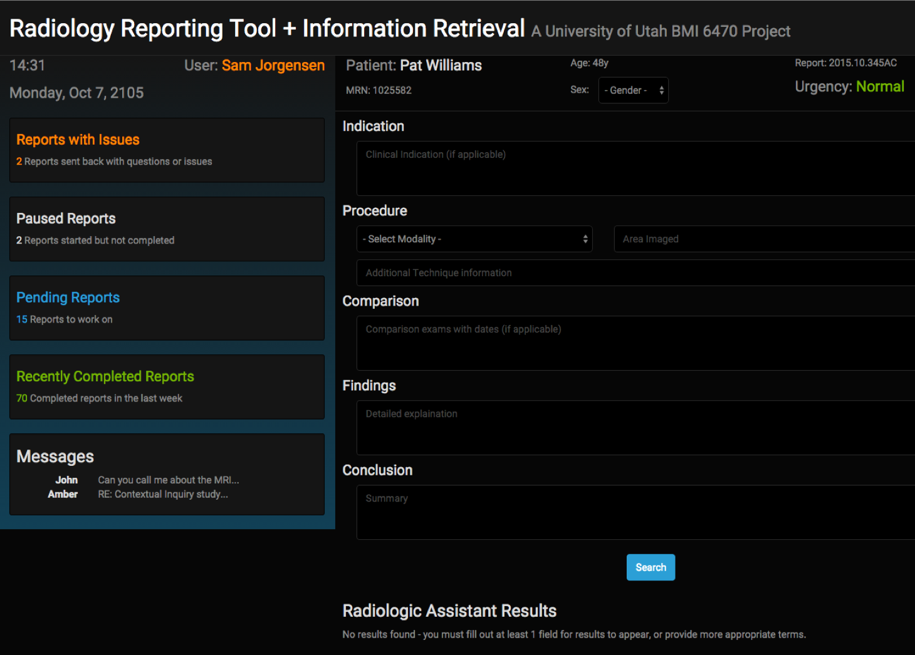
About Seth
Intermountain Care Process Models: https://goo.gl/wBE6ap
https://github.com/magic-lantern/biostatistics-seminar-2017
Notes:
Automating care process models – URL is an excellent resource for standardized care for a range of common conditions.
SMART on FHIR application – using data from EMR walk user through best dosing for antibiotics. Currently on-going project at Intermountain – national need to improve anitbiotic stewardship.
Radiology reporting tools – web scraping, SOLR indexing, REST API to provide real time relevent case guidance

Slide 6
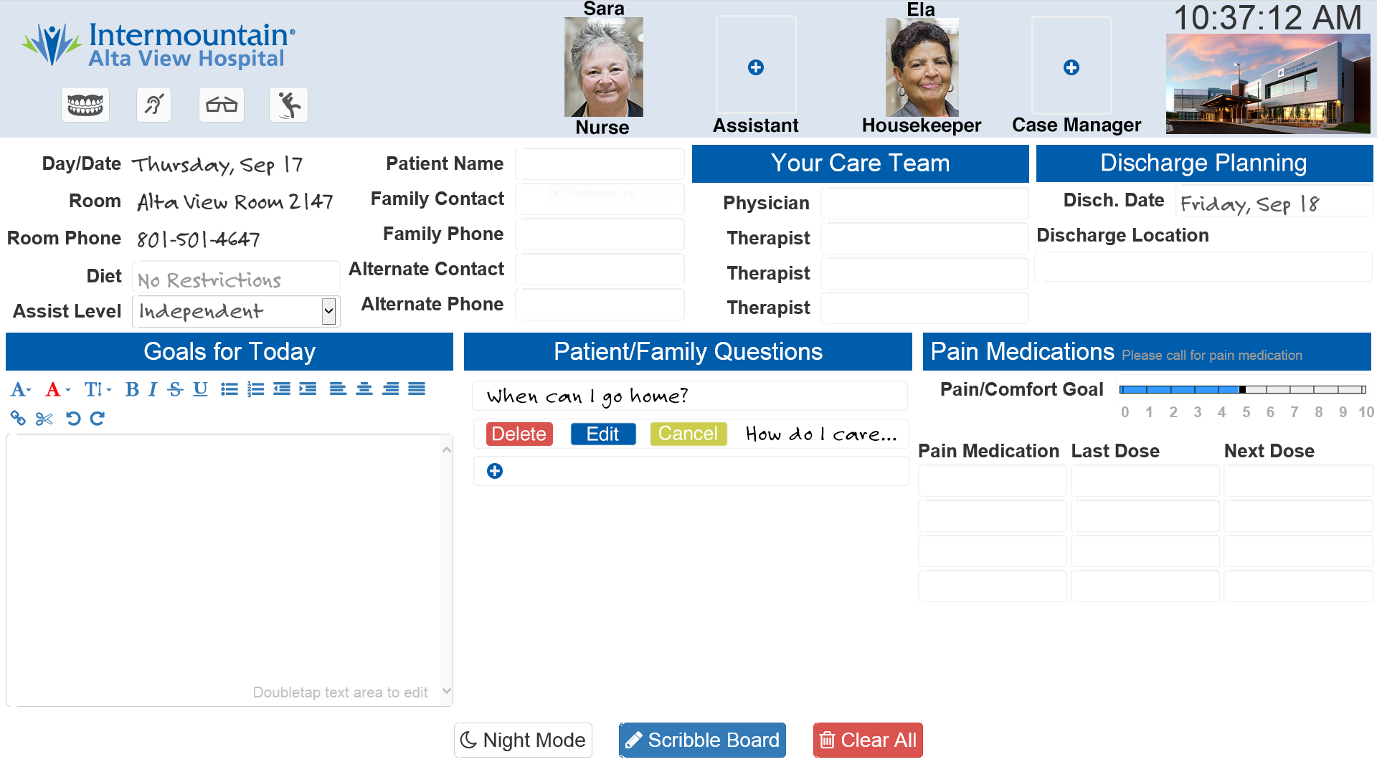
About Seth
Patient Engagement Platform
https://github.com/magic-lantern/biostatistics-seminar-2017
Notes:
Replaced the standard dry erase white board with a 42” touch screen tv – used it as a platform to implement and explore various technologies.
In terms of technology adoption, health care is perhaps 10 years behind consumer tech and many other industries.
Smart Bulbs
Give patient control of their room temperature
RTLS for staff
Interactivity (update goals, ask questions for later, pain medication documentation, communication for shift to shift continuity)
Educational materials
Speech Recognition (Nuance Medical Speech SDK)
Reading data from Cerner (using Millenium API)

Slide 7
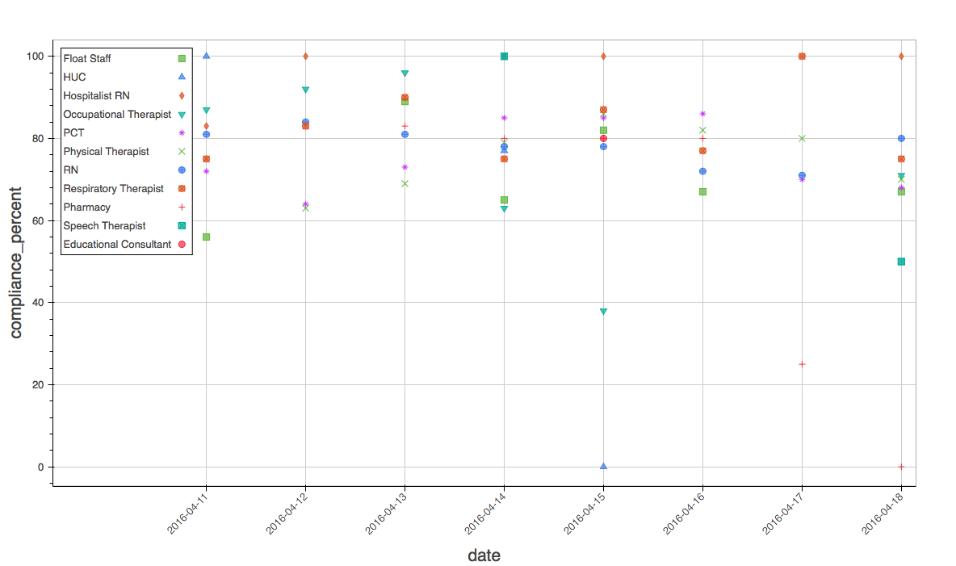
About Seth
Real-time Location Services – Hand Hygiene Compliance
https://github.com/magic-lantern/biostatistics-seminar-2017
Notes:
Analyzing data, evaluating solution.
Infection Control had standard that people entering a patient room had to wash their hands within 60 seconds before or after entering room.
Secret shopper method – similar to Hawthorn effect – people observed change their behavior. RTLS is in the background, so people don’t feel like they’re being observed and thus you can get a better look at true behavior.
Analyzed data, presented findings. RTLS not perfect– some rooms had higher deviation in compliance than others. Some groups of care givers were better than others. day of week had a very large impact on compliance (if I recall correctly, Monday was worst day and compliance improved over the week with Saturday being best)
Wrote white paper on what is needed from a healthcare provider perspective – Cerner and other vendors don’t meet needs

Slide 8
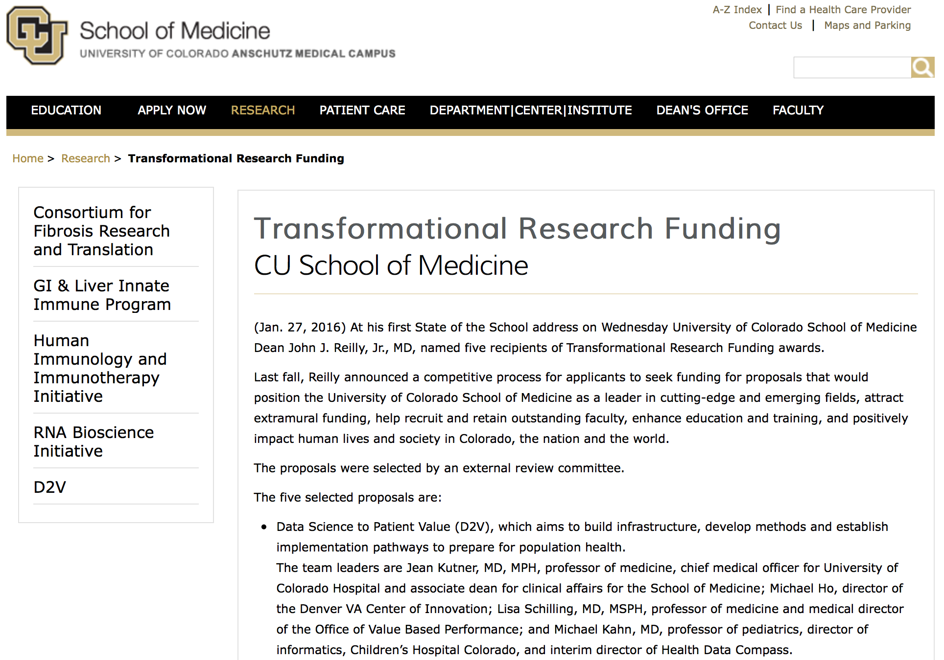
Data Science to Patient Value
https://github.com/magic-lantern/biostatistics-seminar-2017

Slide 9
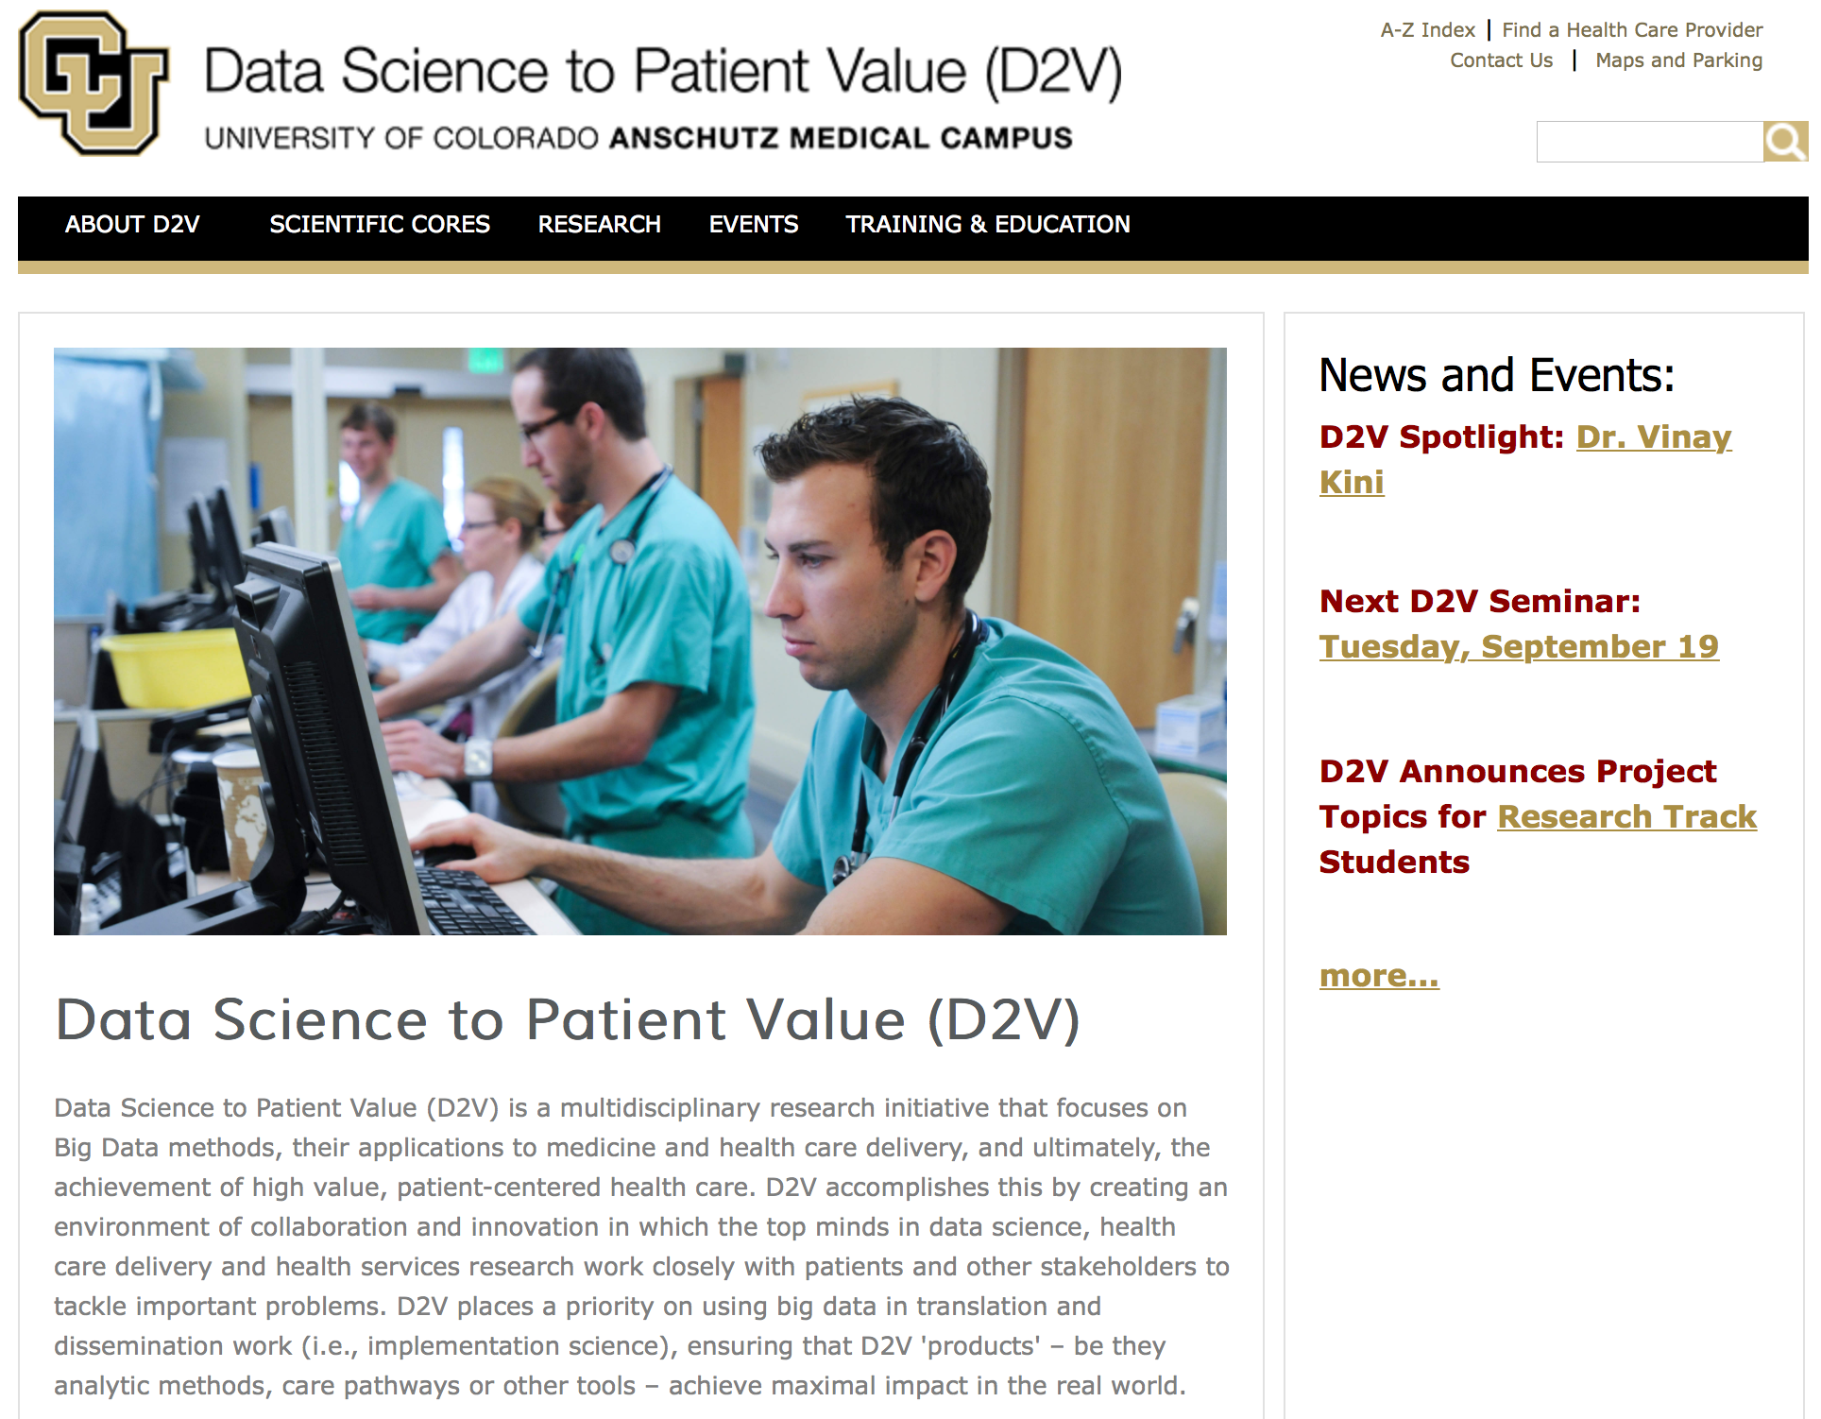
Data Science to Patient Value
Leverage data to improve value in medically complex patients
http://cud2v.org/
Follow Us:
Subscribe​ to our e-mail list
Twitter: @cuD2V​
Facebook: ​​​​​​cuD2V
LinkedIn: D2V
https://github.com/magic-lantern/biostatistics-seminar-2017

Slide 10
Data Science to Patient Value – Scientific Cores
Patient and Systems Value
Data and Informatics
Analytics
Stakeholder Engagement and Governance
Training and Education
Dissemination and Industry Collaboration
https://github.com/magic-lantern/biostatistics-seminar-2017
Notes:
Patient & Systems Value Core- To focus on the science of value from multiple perspectives across the macro health care system.
Data & Informatics Core- To create and sustain investigators access to high-value data assets that are discoverable, accessible, and reliable to facilitate research in data sciences and discovery by providing ‘bleeding edge’ informatics expertise and tools.
Analytics Core-​​ To be a multidisciplinary, collaborative analytic and computational research environment that catalyzes research resulting in innovative applications of complex analytic approaches, and development of novel analytic and computational approaches, methods, and tools.
Stakeholder Engagement & Governance Core- To become the most trusted resource on how best to engage diverse stakeholders in the work of research, implementation and dissemination in health care.
Training & Education Core-​ To train and mentor the next generation of scientists who can advance and integrate the methods of person-centered, high value data science and health systems innovation.
Dissemination & Academic Industry Collaboration Core-​ To disseminate and showcase the work of D2V investigators and increase potential collaborative opportunities with external stakeholders that ultimately lead to increased scientific impact and sustainability of D2V.

Slide 11
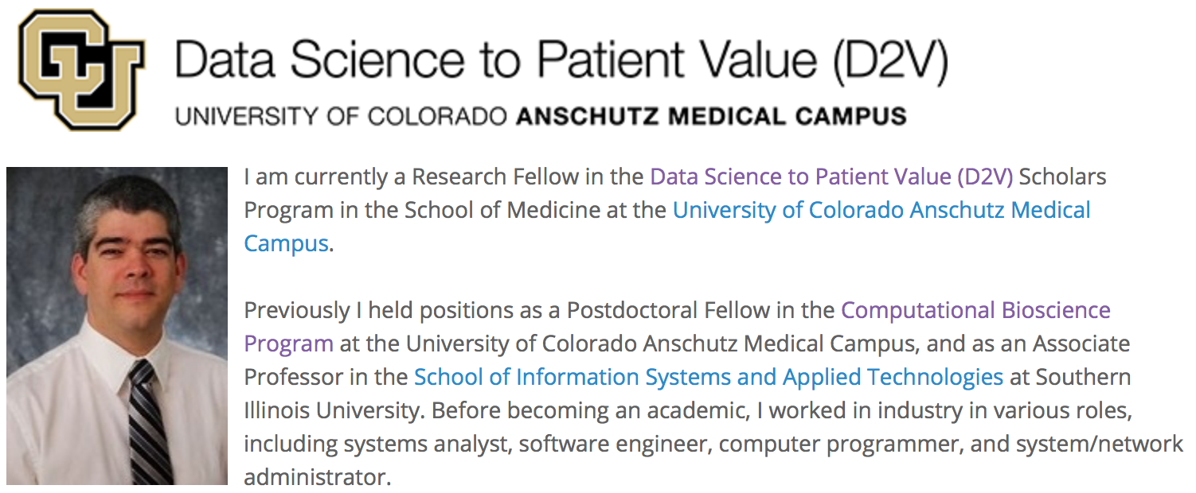
Data Science to Patient Value
Data Science to Patient Value Scholars Program
https://goo.gl/on8PGT
Research Track School of Medicine
https://goo.gl/hnPTFX
D2V Pilot Project Funding Opportunity
https://goo.gl/NvKopi
https://github.com/magic-lantern/biostatistics-seminar-2017
Notes:
D2V will offer three project topic areas this year for students interested in pursuing the Research Track​:
​Data Quality (Mentor: Michael Kahn) Using the Health Data Compass Enterprise Data Warehouse (Mentor: Michael Kahn​) Text Mining (Mentor: Larry Hunter)
Interested students should contact the mentor directly to discuss formulating a research plan as part of their Research Track application.​​
Some of the Pilot Funding Upcoming Projects:
* Linking Research Prioritization with Health Outcomes: A Value-based Approach
* Developing Causal Inference Methods for Nested (or Clustered) Data with Application to Common Pediatric Surgical Conditions
* Big Data to Nursing Value
* Methods for Assessing Sustainability of Health Care Delivery Innovations: Application to Palliative Care for Neurologic Disorders

Slide 12
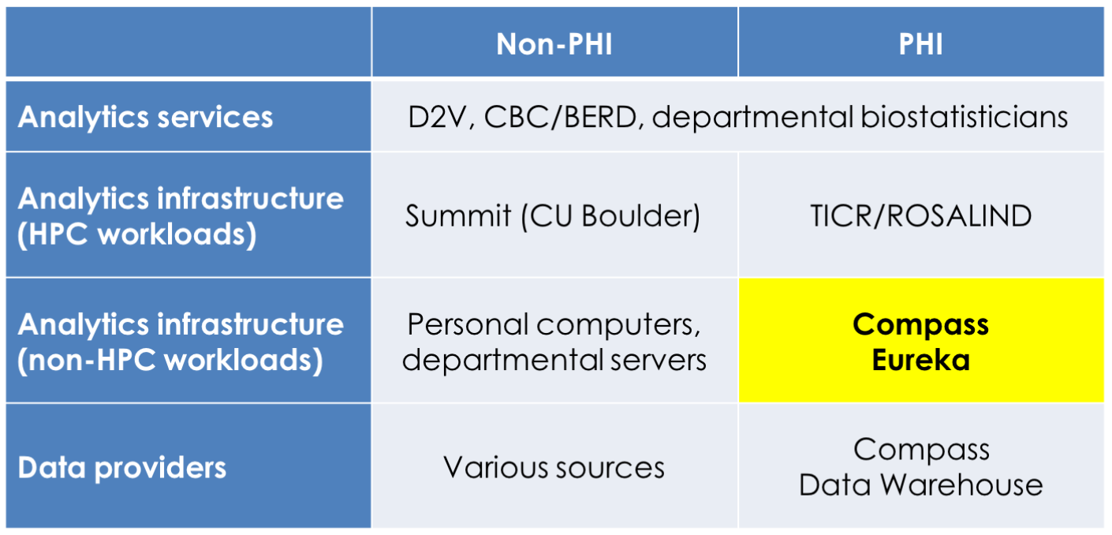
D2V Analytics Core
Analytics Environment to built on common infrastructure using open tools and to promote reproducible research
https://github.com/magic-lantern/biostatistics-seminar-2017
Notes:
Campus Computing Infrastructure
for some projects, inadequate:
memory, processing capability security
Most research projects are reinventing the wheel each time – unique data processing tools, pipleline, infrastructure.
D2V Analytics Core, D2V Informatics Core, and Health Data Compass

Slide 13
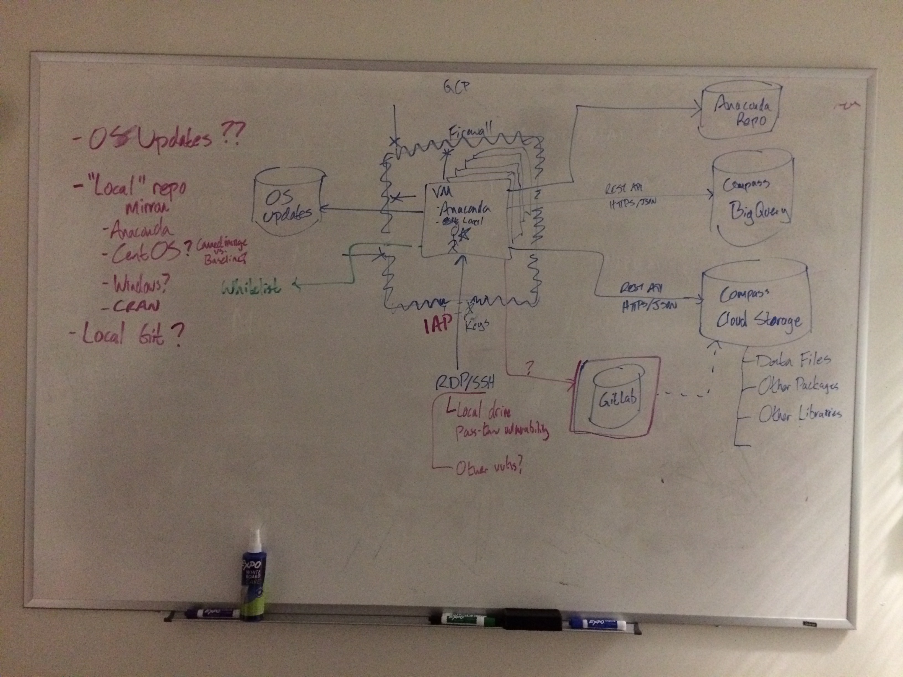
http://healthdatacompass.org
https://github.com/magic-lantern/biostatistics-seminar-2017
Notes:
EUREKA Capabilities (Planned)
Google Cloud (via HDC) - scalable NIST-compliant
Predictable pricing (pay as you go rather than large up front cost with left over resources at the end of a project)
R, Python-based pipelines
Google Cloud services covered under BAA – HIPAA compliant
Google BigQuery
Google Cloud Datalab
Google Cloud Dataproc
Google Cloud Machine Learning
Google Cloud Natural Language API
Google Cloud Pub/Sub
Google Cloud Speech API
Google Cloud Storage
Google Cloud Vision API
Google Compute Engine
Google Genomics

Slide 14
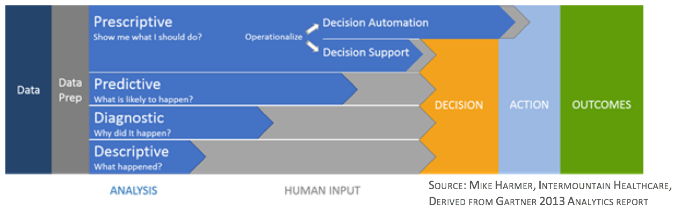
https://github.com/magic-lantern/biostatistics-seminar-2017

Slide 15
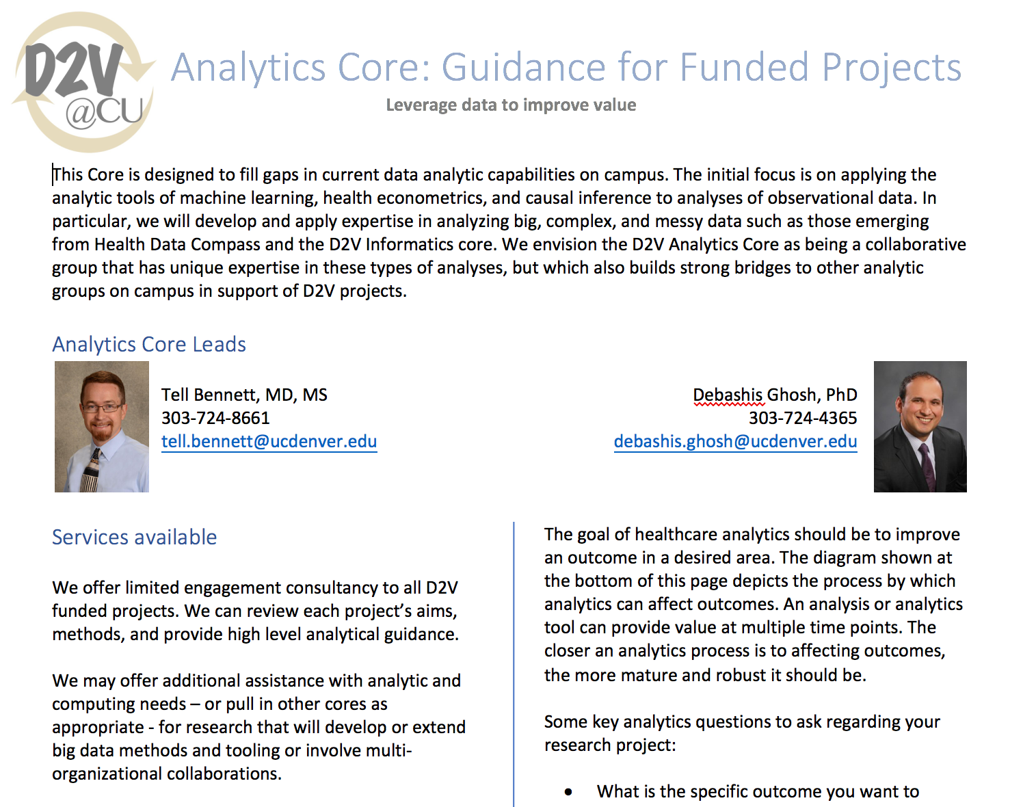
https://github.com/magic-lantern/biostatistics-seminar-2017
Notes:
Attempting to provide brief guidance for all researchers into the area of data analysis, reproducible and replicable research, recommended tooling
Also on the team is Assistant Professor Fuyong Sing (started about two weeks ago)

Slide 16
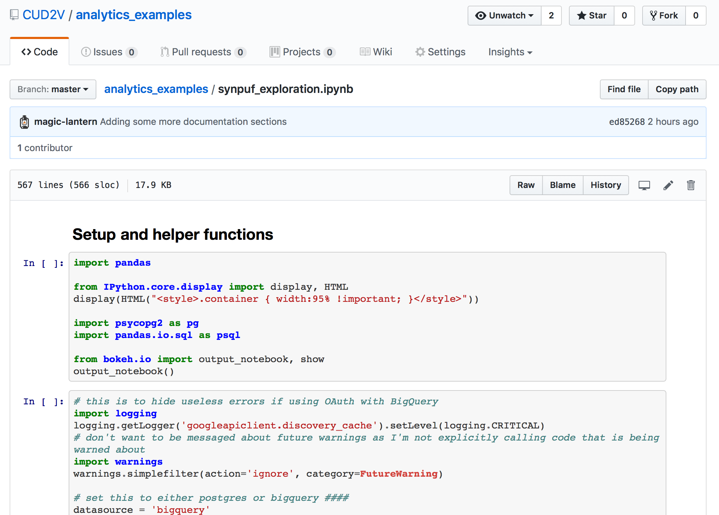
https://github.com/CUD2V/analytics_examples
https://github.com/magic-lantern/biostatistics-seminar-2017

Slide 17
KDD 2017 Highlights
About 1700 attendees
Paper acceptance rate ~9%
Poster acceptance rate ~10%
Workshops/Tutorials acceptance rate ~60%
$540k in sponsorships
https://github.com/magic-lantern/biostatistics-seminar-2017
Notes:
Knowledge Discovery and Data mining conference – special interest group under the Assocation for Computing Machinery.
This year the conference was in Halifax Canada – next year will be in London. Moves all over the globe.
Focused on research in the KDD space, but recently has started to add more practical component – hands on tutorials are very popular. Getting a chance to use a new library, tool and ask people questions. For example University of Illinois NLP project “meta-toolkit” Tensorflow, R on spark,

Slide 18
KDD 2017 Highlights
User voted best video (paper summary) : https://youtu.be/G-omu_ki7YM
Videos of all presentations not yet available. Should be available on youtube in the next few weeks- search “kdd2017”
Accepted Papers Available at http://www.kdd.org/kdd2017/accepted-papers many have short video introduction/overview
https://github.com/magic-lantern/biostatistics-seminar-2017
Notes:
User voted best video (paper summary) : https://youtu.be/G-omu_ki7YM - reinforcement learning approach using the bandit algorithm that finds a balance between exploration and exploitation of a given problem space. This video demonstrated their approach using clothing selection for a date.
I though the best keynote was: Bin Yu "Three Principles of Data Science: Predictability, Stability, and Computability” – video not yet available though

Slide 19
KDD 2017 Highlights
Trends
Machine Learning can be applied to any domain
Hyperparameter Tuning
How to scale to handle larger data, more CPU needs
Working to migrate from supervised learning methods to unsupervised methods
The real bottle neck to analysis is people
Research problems
Healthcare specific topics
Relevant Paper: http://www.kdd.org/kdd2017/papers/view/patient-subtyping-via-time-aware-lstm-networks
https://github.com/magic-lantern/biostatistics-seminar-2017
Notes:
Trends
Machine Learning can be applied to any domain
Sports - luck vs skill
Medicine (hopefully all of you know this already)
Climate
Traffic - KDD Cup challenge
Social Networking
Safety - terrorism, water quality (flint michigan)
Hyperparameter Tuning
Google Vizier
How to scale to handle larger data, more CPU needs
Spark
Cloud computing - AWS (biggest coverage), Google Cloud, Microsoft Azure
Building R into other platforms (MS SQL Server)
Working to migrate from supervised learning methods to unsupervised methods
The real bottle neck to analysis is people
computing resources are cheaper all the time
more data are available all the time
people are the bottleneck
Data Science cannot scale with just software nor just hardware - nor even scale software + hardware
Research problems
Too much information - too many papers, too many ‘discoveries’. We need fewer and better quality papers. Do more science!
Every project “re-invents the wheel”
Need to join public data sets with private data
Getting results/decisions/predictions from unstructured data - natural language, images, streaming data
Replication is very important.
Healthcare specific
Getting access to EMR data is hard - much easier to access data people post online (Twitter, Facebook, forums, etc)
Methods of data imputation (ethnicity or gender based on name)
European Union data protection regulation - right to explanation or results of an algorithm must be human interpretable
Machine learning applied to adverse drug reactions - attended 2 sessions on this
Relevant Paper: http://www.kdd.org/kdd2017/papers/view/patient-subtyping-via-time-aware-lstm-networks Time-Aware Long short term memory (a type of recurrent neural network - RNNs are networks with loops) to handle irregular time intervals in longitudinal patient records. We propose a patient subtyping model that leverages the proposed T-LSTM in an auto-encoder to learn a powerful single representation for sequential records of patients, which are then used to cluster patients into clinical subtypes.
Hands on sessions mostly used R/Python, papers/presentations/posters were algorithm/math focused.

Slide 20
KDD 2017 Highlights
Sub-Conference: Big data analytics-as-a-Service: Architecture, Algorithms, and Applications in Health Informatics
Top Challenges
Privacy & Security
Compliance with regulations
Mobile Computing
Sharing of data
Lack of Integration between clinical and administrative systems
Operational Analytics
Lack of analytics or people with analytics skills
Sub Conference Papers: http://bigdas.org/callforpapers/
Videos should be posted to YouTube along with rest of conference
https://github.com/magic-lantern/biostatistics-seminar-2017
Notes:
Monday - BigDAS meeting:
A couple of different presentations plus a discussion panel
Presentation on Analyzing user generated content
Adverse drug reaction identification
Entity matching between disparate data - crowd sourcing tools
Every project “re-invents the wheel”

